Slide 1
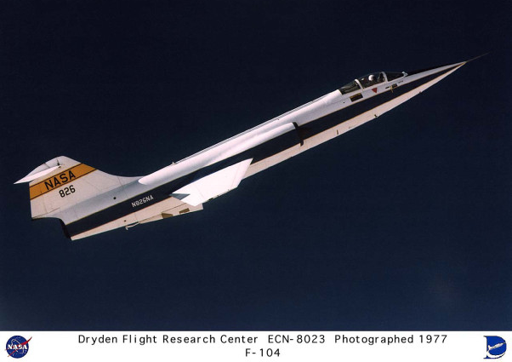
II. Climb and acceleration performance
Notes:
II - <number>
Issue 1 – Feb 2011
II – Climb and acceleration performance
In straight and steady level flight, lift must balance weight and thrust must balance drag.
In this section, we are dealing with the consequences of an excess of thrust : if thrust exceeds drag, the airplane climbs or accelerate in level flight, its total energy increasing.
This chapter concentrates on climb performance, but we must stress that equations are valid also for descent performance, when drag exceeds thrust.
Illustration : First generation Mach 2 fighter Lockheed F-104 « Starfighter » operated by NASA (1977).

Slide 2
1. Equations for straight climb
Flight path angle and vertical speed
Vertical speed : Vz = dz = V_{k} sin γ_{k}
dt
Vertical speed
Vk
Ground speed
Vz
γ_{k}
flight path angle
W
Vz
Vk
V
True airspeed
γ_{a}
aerodynamic flight path angle
If zero vertical wind : Vz = V sin γ_{a}
Notes:
The vertical speed (also called rate of climb) is the vertical component of the velocity vector (relative to the ground) :
Vz = V_{k} sin γ_{k}
Flight path angle, γ,_{k} may be defined as the angle between the velocity vector relative to ground and the horizontal plane : it is positive when aircraft is climbing.
Aerodynamic flight path angle, γ,_{a} may be defined as the angle between the velocity vector relative to the air (true airspeed) and the horizontal plane : it is positive when aircraft is climbing (relative to the air).
If there is no vertical wind component, vertical speed is equal to the vertical component of the aerodynamic velocity vector :
Vz = V sin γ_{a}
Vertical speed is usually expressed in ft/mn (100 ft/mn = 0.508 m/s).
Vertical speed may be obtained from inertia sensors or may be estimated from the time derivative of static pressure.
In this section we will consider climb, descent and acceleration in level flight performance under two hypothesis :
zero vertical wind
constant horizontal wind component

Slide 3

1. Equations for straight climb
Lift
Z
Velocity vector
Thrust
V
x
F
γ_{a}
Drag
X
Aerodynamic flight path angle
!
Constant wind hypothesis
Weight
mg
z
Equations are written in aerodynamic reference system
Propulsion equation : m = F - ½ρV²SCx - mg sin γ_{a}
Lift equation : mg cos γ_{a} = ½ρV²SCz
Notes:
II - <number>
Issue 1 – Feb 2011
II – Climb and acceleration performance
This slide presents the forces acting on an airplane in straight climb at zero sideslip.
Forces are projected along aerodynamic axes (aerodynamic reference system is defined in the next section of this course).
Along x axis, which is parallel to the velocity vector (true airspeed), the forces are :
Thrust F (we assume that thrust is parallel to the velocity vector)
Drag X, opposed to thrust
Weight component : - mg sinγ_{a}
Equilibrium of forces may not be achieved : tangential acceleration (along the trajectory) results from the propulsion equation. Since we assume that wind is constant, tangential acceleration is the time derivative of true airspeed. In the general case, it is the time derivative of ground speed.
Along z axis, which is normal to the velocity vector :
Lift Z
Weight component : mg cosγ_{a}
In straight climb, lift must balance weight component, as expressed in the lift equation : normal acceleration is zero. As a consequence, lift is lower than weight.
Notes
Normal thrust component Fz is neglected.
The above equations are valid as well for descent. In this case, flight path angle γ_{a} is negative. Weight component along z axis is the same as in climb and weight component along x axis is positive instead of being negative.

Slide 4

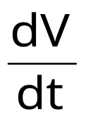

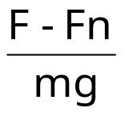
1. Equations for straight climb
Propulsion equation :
mg (sin γ_{a} + ) = F - ½ρV² S Cx
Low climb angle hypothesis : cos γ_{a} ≅ 1
  Lift equation for straight and level flight is still valid
  mg = ½ρV² S Cz
  At a given speed and altitude, lift and drag coefficients are the same as in straight and level flight
  ½ρV² S Cx = Fn = mg
  Propulsion equation : sin γ_{a} + =
Notes:
II - <number>
Issue 1 – Feb 2011
II – Climb and acceleration performance
This slide presents the propulsion and lift equations in the case of a straight climb, when vertical thrust component is neglected and assuming that climb angle is small, meaning that lift balances weight, as in level flight.
As a consequence, lift coefficient is the same as in level flight at the same speed. Since drag depends on lift coefficient and Mach number, drag is the same as in level flight : drag equals thrust required for level flight.
Note : The low climb angle hypothesis will be retained in this section. We must stress that this hypothesis do not alter the results in a significant manner. When thrust to weight ratio is high, allowing to climb at high flight path angle, it is positive to compute climb angle in several iterations : at the first iteration, climb angle is computed assuming that cosγ_{a} is equal to 1, then using the result of the computation for the second computation step. Convergence is usually achieved within a few iterations.

Slide 5
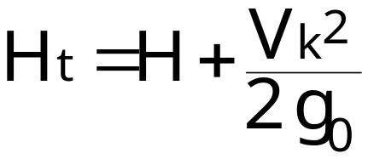
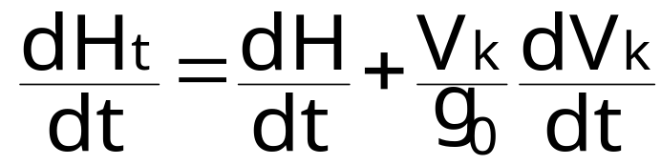
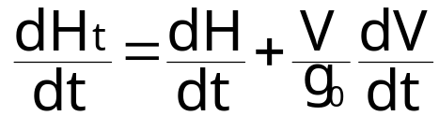
1. Equations for straight climb
Total vertical speed
V_{k}
Total energy : kinetic energy + potential energy
  E_{t} = ½ m V_{k}² + m g₀ H = m g₀ H_{t}
z ≅ H
Total height :
Total vertical speed :
Zero wind :
Notes:
When writing the expression for total energy, we neglect the kinetic energy from A/C rotation along its axes. In the case of straight climb, this component is zero.
In this expression, geopotential altitude H is used, instead of geometric altitude z, since potential energy from earth gravity is function of geopotential altitude. Geopotential altitude is proportional to the potential energy, the ratio being the weight at sea level (g₀ is the gravity acceleration at sea level).
Total height Ht (which could have been called total altitude) allows to express total energy as an equivalent altitude :
Total height is the altitude that could be reached when converting all the kinetic energy into potential energy. In reality, it is not possible to convert all the kinetic energy into potential energy, since a minimum airspeed is required to avoid a loss of control and there are losses due to drag.

Slide 6
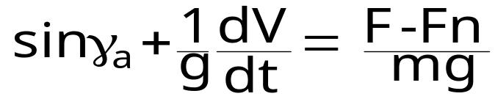
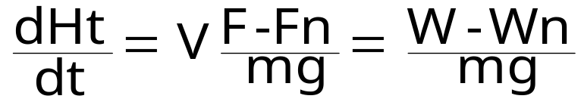
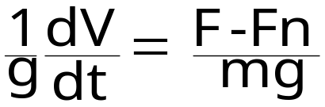
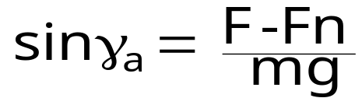
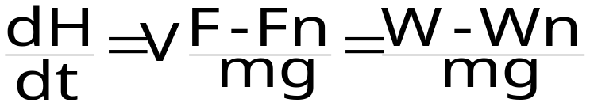
1. Equations for straight climb
Propulsion equation under zero wind hypothesis :
  W is the power (V.F) and Wn is the power required for level flight
  Acceleration in level flight :
  Climb angle and vertical speed at constant true airspeed :
Notes:
Propulsion equation allows to express the addition of sinus of climb angle (or the climb angle expressed in radians in the context of small climb angle hypothesis) and the acceleration divided by g (or acceleration expressed in « g »), as a function of the specific excess thrust.
Multiplying the first expression by the true airspeed V allows to obtain the total vertical speed as a function of true airspeed and excess thrust (difference between thrust and thrust required). Since power is thrust multiplied by true airspeed, we obtain total vertical speed as a function of excess power.
We then obtain the expressions for acceleration in level flight and climb angle (and vertical speed) at constant true airspeed.
Through the propulsion equation and the definition of total vertical speed (and total energy), we find that there is equivalence between acceleration and climb angle.
It must be reminded that we assume a constant wind hypothesis. As a consequence, when wind is constant, a constant true airspeed corresponds to a constant ground speed. The above relations are no longer valid when wind varies.
Note : Potential flight path angle γ_{t} may be defined in relation to total vertical speed, as flight path angle is defined in relation to vertical speed.
Assuming the current hypothesis, potential flight path equals specific excess thrust, which may be defined as the ratio between excess thrust and weight (excess thrust being the difference between thrust and thrust required).

Slide 7
1. Equations for straight climb
If thrust exceeds drag :
  the airplane climbs and/or accelerates
  the total vertical speed is positive : total energy increases
Excess thrust may be defined as the difference between thrust and thrust required : F-Fn
Specific excess thrust is the ratio between excess thrust and weight :
  In level flight (expressed in « g ») it is equal to the acceleration in « g »
  In climb (or descent) at constant true airspeed, it is equal to sin γ_{a} (γ_{a} is the climb angle)
Notes:
Excess thrust is the difference between actual thrust F and thrust required for level flight Fn.
Specific excess thrust is the excess thrust to weight ratio, which is non dimensional.
Assuming a low value for flight path angle, (drag may be approximated by thrust required for level flight)the expression for propulsion equation becomes :
Excess power is defined as the difference between propulsive power and power required for level flight.
Specific excess power may be defined by the ratio between excess power and weight.
Under the current hypothesis, total vertical speed is equal to specific excess power.

Slide 8
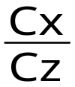

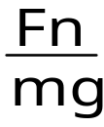
1. Equations for straight climb
Power off descent
Z
Lift
Drag
γ_{a}
X
x
V
Weight
mg
z
Exact equation : tan γ_{a} = - = -
Approximation cos γ_{a} ≅ 1 : sin γ_{a} = - = -
Notes:
II - <number>
Issue 1 – Feb 2011
II – Climb and acceleration performance
This slide presents power off descent. Assuming zero power (or zero power).
The typical case for power off descent is the glider.
If thrust is lower than drag, the flight of an airplane is similar to the flight of the glider. With engines at idle thrust of power, thrust is close to zero but :
In the case of jet engines, idle thrust is positive (small residual thrust)
Propeller thrust at idle power is usually negative at high speeds (due to negative propeller efficiency at high advance ratio).
It must be stressed that lift to drag ratio for gliders is usually high (high performance gliders have a maximum L/D in excess of 50). A glider must be towed to gain a minimal altitude, then it relies on vertical wind movements (updrafts) to continue its flight.

Slide 9

2. Thrust - drag equilibrium in level flight
Thrust
F
Thrust drag equilibrium
for thrust lever angle τ
Thrust required
Fn(V)
τ
F(τ,V)
Available thrust
for thrust lever
angle τ
min. Fn
Max. L/D
True Airspeed
V
Region of reversed
command
Region of normal command
(F(τ,V) - Fn(V)) = 0
Notes:
II - <number>
Issue 1 – Feb 2011
II – Climb and acceleration performance
To maintain straight and level flight at a given true airspeed V, thrust levers must be set so as to achieve thrust-drag equilibrium (engine thrust must be equal to thrust required) :
F (τ,V) = Fn (V)
In the region of normal command, thrust drag equilibrium in straight and level flight is stable, while it is unstable in region of reversed command (cf next slide).
The limit between those two regions is the true airspeed for which the thrust required and the engine thrust curves are tangent.
In the case of a jet engine airplane, this limit is close to the minimum thrust required (maximum L/D), while it is close to the minimum power required in the case of a propeller airplane.

Slide 10
2. Thrust - drag equilibrium in level flight
Thrust
F
Fn(V)
Region of normal command
From equilibrium speed Veq. :
Positive speed increment
⇒ F < Fn (drag exceeds thrust)
Return to equilibrium speed.
F(τ,V)
TAS
V_{eq.}
V_{eq.}+ ΔV
Thrust
F
Region of reversed command
Fn(V)
From equilibrium speed Veq. :
Positive speed increment
⇒ F > Fn (thrust exceeds drag)
Speed increment increases.
F(τ,V)
TAS
V_{eq.}
V_{eq.}+ ΔV
Notes:
II - <number>
Issue 1 – Feb 2011
II – Climb and acceleration performance
This slide presents the stability of thrust-drag equilibrium in straight and level flight.
In the region of normal command, the thrust required versus speed slope is higher than the engine thrust versus speed slope :
In the above example we assume that thrust-drag equilibrium is achieved at speed Veq, for thrust lever angle τ : Fn(V_{eq.}) = F(τ,V_{eq})
In the region of normal command, when speed increases above V_{eq}, thrust required Fn(V) becomes greater than engine thrust F(τ,V_{eq}) : as a consequence, airplane decelerates if level flight is maintained (if speed decreases below V_{eq}, the airplane accelerates in level flight).
In the region of reverse command, thrust drag-equilibrium becomes unstable in level flight : if a positive speed increment is observed, engine thrust F(τ,V_{eq}) becomes greater than thrust required Fn(V) and the airplane continue to accelerate (if speed decreases below V_{eq}, the airplane decelerates in level flight).

Slide 11
2. Thrust - drag equilibrium in level flight
Region of reversed command
In the region of reversed command, maintaining a selected airspeed in level flight requires more pilot workload.
Instability is more severe for :
  Jet airplanes
  Low aspect ratio wings (higher induced drag)
Approach phase is critical : low speed, high drag, constant slope (similar to level flight).
Notes:
II - <number>
Issue 1 – Feb 2011
II – Climb and acceleration performance
Due to instability of thrust drag equilibrium, thrust control to maintain a constant airspeed in the region of reverse command requires higher workload, since the pilot must compensate any speed deviation.
Thrust – drag equilibrium instability is less severe for propeller airplanes, due to the evolution of propeller thrust as a function of speed (if propulsive power is constant, thrust is inversely proportional to airspeed).
At lower speeds, thrust required increase is due to induced drag, therefore, instability is more severe for airplanes with low aspect ratio wings, such as supersonic airplanes.
Usually, initial climb speeds and approach speeds for jet airplanes are in the region of reversed command.
However, on initial climb, thrust is constant (maximum take-off thrust or maximum climb thrust) and speed stability depends on longitudinal static stability, which is usually positive.
This is why approach is the more critical flight phase for thrust-drag equilibrium stability, since a constant flight path angle is required (similar to level flight).

Slide 12
3. Optimum climb speeds
Best climb angle and best vertical speed
If thrust exceeds drag, speed for best vertical speed is greater than speed for best climb angle.
Best vertical
speed
Best climb
angle
Notes:
II - <number>
Issue 1 – Feb 2011
II – Climb and acceleration performance
Optimum climb is to be defined according to the flight conditions :
Best climb angle maximizes obstacle clearance in initial climb or go around.
Best vertical speed minimizes time to climb to cruising altitude.
For a transport airplane, economical climb speed is usually greater than the speed corresponding to best vertical speed, which minimizes time to climb to optimum altitude.
If thrust exceeds drag, airspeed for best climb angle is lower than speed for best vertical speed :

Slide 13
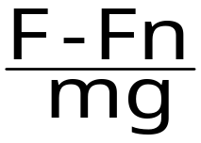
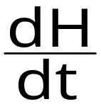
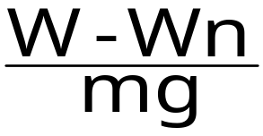
3. Optimum climb speeds
At constant TAS :
  Best climb angle is obtained for maximum excess thrust.
  Best vertical speed is obtained for maximum excess power.
For a jet airplane, assuming constant maximum thrust as a function of speed, best climb angle will be obtained for maximum lift over drag ratio (minimum thrust required)
sin γ_{a} =
=
Notes:
II - <number>
Issue 1 – Feb 2011
II – Climb and acceleration performance
This applies to climb at constant TAS. When climbing at constant CAS or at constant Mach number, acceleration term has to be taken into account :
However, as an approximation, we may consider that best angle is obtained at a speed close to the speed corresponding to maximum excess thrust and that best vertical speed is obtained at a speed close to the speed corresponding to the maximum excess power.
Based on the constant thrust approximation for a jet airplane, best climb angle is obtained at the speed corresponding to maximum lift over drag ratio, and best vertical speed is obtained at a higher speed.

Slide 14
3. Optimum climb speeds
Thrust
F
Optimum climb angle (jet airplane)
Maximum engine thrust Fu
Max. climb angle
Thrust required Fn
min. Fn
Excess thrust
ΔF = Fu - Fn
Max.
L/D
True Airspeed
V
Stall
Notes:
II - <number>
Issue 1 – Feb 2011
II – Climb and acceleration performance
In the case of a jet airplane, speed corresponding to optimum climb angle is close to the speed corresponding to maximum lift over drag ratio : if maximum engine thrust is constant (does not depend on speed), maximum excess thrust corresponds to minimum thrust required (which corresponds to best lift to drag ratio).
As a first approximation, we may consider that best climb angle is obtained for the speed corresponding to maximum lift to drag ratio.
Note : In the case of a glider, thrust is zero and, therefore, does not depend on speed. Maximum climb angle is negative, it corresponds to minimum glide angle and is obtained for best lift to drag ratio.

Slide 15
3. Optimum climb speeds
Cz
Stall
Cz_{max}
MaxL/D
Increasing Airspeed
Max. climb angle
Jets
Max. vert. speed
Cx
Notes:
II - <number>
Issue 1 – Feb 2011
II – Climb and acceleration performance
This slide presents, on a drag polar, lift coefficients corresponding to optimum climb speeds for jet airplanes.
Considering jet airplanes, initial climb speeds (after take-off) are ussually lower than optimum climb angle speed, since they must be kept as low as possible, in order to minimize take-off field length.

Slide 16
4. Propulsion ceiling
When altitude increases :
  Maximum engine thrust Fu decreases
  Minimum thrust required Fn_{min} increases due to compressibility
Propulsion ceiling is altitude corresponding to zero excess thrust (or power) :
  Propulsion ceiling decreases when mass increases : Fn_{min.} is proportional to m,
  Propulsion ceiling decreases when temperature increases : Fu decrease when temperature increases
Notes:
II - <number>
Issue 1 – Feb 2011
II – Climb and acceleration performance
Propulsion ceiling is the maximum theoretical altitude for which maximum thrust equal thrust required : thrust equals drag.
Propulsion ceiling may be defined using power or thrust : power is used for propeller airplanes and thrust is used for jet airplanes.
Propulsion ceiling is a function of aircraft mass and air temperature. It increases when mass decreases and when temperature decreases.
Airplane altitude may be limited by other considerations detailed in the chapter dedicated to flight envelope : lift ceiling is the maximum altitude for which lift equals weight, it does not depend on temperature.

Slide 17
4. Propulsion ceiling
Vertical speed
Vz (ft/mn)
Max. γ_{a}
Max. Vz
Zp₁
Zp₂
300 ft/mn
Zp₃
0
Zp₄
True Airpeed
V
Increasing altitudes Zp₁ < Zp₂ < Zp₃ < Zp₄
Zp₄ is the propulsion ceiling
Zp₃ is the service ceiling (Vz 300 ft/mn)
Notes:
II - <number>
Issue 1 – Feb 2011
II – Climb and acceleration performance
This slide presents vertical speed as a function of true airspeed, at increasing altitudes.
The service ceiling is the maximum altitude for which it is possible to climb at a given vertical speed (here 300 ft/mn).

Slide 18
4. Propulsion ceiling
Service ceiling : maximum altitude allowing for a minimum vertical speed capability.
  Usual values : 100 ft/mn for light airplanes, 300ft/mn for commercial jets, 1 000 ft/mn for fighters.
One (two) engine(s) out ceilings :
  « Gross ceiling » is propulsion ceiling,
  « Net ceiling » allows for a climb gradient margin, varying with number of engines. Climb gradient margins are defined by airworthiness regulations (FAR/CS 25).
Notes:
II - <number>
Issue 1 – Feb 2011
II – Climb and acceleration performance
Service ceiling is an operational notion, defined with all engines operating. The minimum value for vertical speed may vary according to the aircraft type : a 100 ft/mn vertical speed may be adequate for a light airplane, while commercial jets required a 300 to 500 ft/mn vertical speed.
Airworthiness regulations define one engine inoperative ceiling (and two engines inoperative ceilings for 3 and 4 engine airplanes).
One engine inoperative :
1.1 % (two-engine A/C)
1.4 % (three-engine A/C)
1.6 % (four-engine A/C)
Two engines inoperative
0.3 % (three-engine A/C)
0.5 % (four-engine A/C).

